Slide 1
Cash Estimation Model
Coursework : BUAN 5270 Analytics For Financial Decisions and Market Insights
Contributors:
Rabiya Fatima
Sri Lakshmi Mallipudi
Amrapali Samanta
Barkha Sharma

Slide 2


Understanding the Importance of Sufficient Cash
Sufficient cash flow empowers a firm by fostering operational flexibility, seizing investment opportunities, reducing debt burdens, and fueling innovation initiatives.
Impact of Cash Flow | Sufficient Cash Flow | Low Cash Flow
Operational flexibility
Investment Opportunity
Innovation
Debt Reduction
Notes:
Operational Stability: Adequate cash flow ensures day-to-day operational needs are met, including paying employees, covering utility bills, and managing inventory.
Investment Opportunities: Positive cash flow provides firms with the financial capacity to invest in growth opportunities, whether through expanding operations, acquiring assets, or investing in research and development.
Debt Reduction: Firms can service existing debts and maintain healthy relationships with creditors by consistently meeting payment obligations. Sufficient cash balance will stop the firms from taking additional debts ultimately resulting in less interest expenditure.
Innovation: Allocate resources to research and development, fostering innovation and staying competitive in the market.

Slide 3
Proposed Cash Estimation Models
Model 1 for cash estimation:
Cash = Intercept + Firm size + NetWorkingCapital + Capital Expenditures + IndustrySigma + R&D +Dividend Dummy + SalesGrowth + CashfromOperations + FirmAge + TaxBurdenonForeignIncome+ YearDummies +IndustryDummies + Managerial Ability + Error
Model 2 for cash estimation:
Cash = Intercept + Firm size + NetWorkingCapital + Capital Expenditures + IndustrySigma + R&D +Dividend Dummy + SalesGrowth + CashfromOperations + FirmAge + TaxBurdenonForeignIncome+ YearDummies +IndustryDummies + Managerial Ability + Leverage + MarketToBook + InterestRates + Error
Notes:
Model 1:
Cash flow is the target variable and utilizing
fundamental variables : Firm Size, Net Working Capital, and Capital Expenditures , Cash from Operations
Industry-specific parameters : Industry Sigma and R&D expenses, this model offers a holistic view.
The inclusion of Dividend Dummy, Sales Growth, firm age and reflects the diverse aspects influencing cash flow.
Additionally, we've considered Managerial Ability and incorporated temporal and industry-related nuances with YearDummies and IndustryDummies.
Model 2:
Along with variables used in model 1 we have 3 more variable to experiment potential impacts of additional factors on cash flow.
We Used Leverage , Market to Book ratio to capture market perceptions and Interest Rates to consider the cost of capital.

Slide 4
Data Overview and Data Processing
Data Source : WRDS Compustat - Fundamentals Annual for North America (1960-2022)
PROCESS | STEPS FOLLOWED
Time Period | 1975 - 2022
Filter Criteria | Positive Total Assets Positive Net Sales Excluded firms with year end stock price < $2 Excluded Utility and Financial firms Excluded missing common Shareholders equity
Data Cleaning | Sort by relevant variables Remove duplicates Handling missing values
Data Transformation | 'gvkey' Numeric Conversion datadate' Year Extraction 'sic' Digits Extraction
Merging | Identified unique key gvkey, nyear across variables
Winsorization | Identify and address outliers Apply winsorization at 1% and 99% to mitigate outlier impact.
Notes:
Filter criteria :
We excluded entities with negative total assets and net sales. This criterion helps us narrow our analysis to companies with positive revenue streams.
We also excluded firms with year end stock price <$2 to maintain a certain financial level
We excluded financial and utility firms as these firms follow different regulatory rules and law to calculate cash flows.
Included firms with having data about common shareholder’s equity. This criteria ensures to include ownership structure for firms.
Data cleaning :
The sorting step provides a clear structure, and enhance the efficiency of our analysis.
Eliminating duplicates safeguards against potential biases and errors in our findings.
Handling missing values is a meticulous task; we employed methods like imputation or exclusion based on the nature of missingness.
Data transformation : '
gvkey' Numeric Conversion: Typecast 'gvkey' to numeric ('gvkey2').
'datadate' Year Extraction: Derive 'nyear' from 'datadate' for year representation.
'sic' Digits Extraction: Form 'sic2' by obtaining the first two digits of 'sic' through division by 100.
Merging :
Identifying unique identifiers ensures datasets are aligned accurately during merging
Coordinating the merging process is pivotal for maintaining data integrity.
The resulting dataset provides a holistic perspective, essential for robust empirical investigations. Following the data merge, the dataset was constrained, initiating from 1980 due to the limited availability of cash from operations data, which commenced from 1987
Winsorization :
Managing outliers is crucial for maintaining data quality and consistency.
Winsorization ensures robustness by limiting the influence of extreme values.

Slide 5
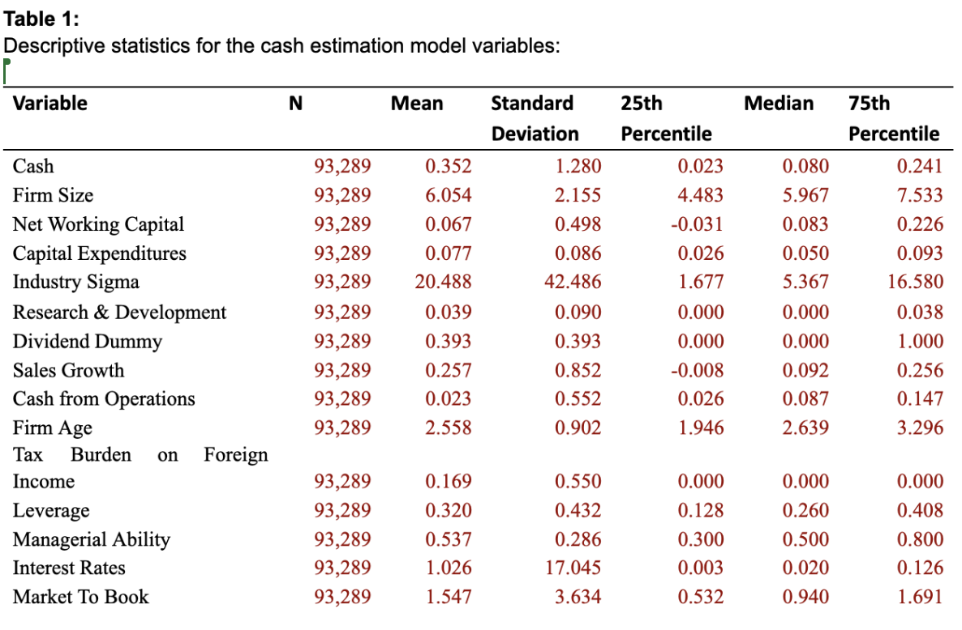
Insights into Descriptive Statistics on Merge Dataset
Notes:
The descriptive statistics reveal insightful patterns in the dataset used for our cash estimation model. The average cash level across firms is 0.352, with a notable standard deviation of 1.280, indicating considerable variation. Firms, on average, have a size of 6.054, while net working capital shows a mean of 0.067, with some companies experiencing negative values. Capital expenditures exhibit a mean of 0.077, displaying moderate investment activities. In terms of R&D expenditure, firms allocate a relatively small portion of their resources to R&D activities with a mean of 0.039. Notably, a significant portion of firms (25th percentile) report zero R&D expenditures, suggesting a diverse landscape in R&D Investment, with some firms either not engaging in such activities or investing minimally. Industry sigma, exhibits substantial diversity with a mean of 20.488. Dividend payments are prevalent, as indicated by the mean value of 0.393. Sales growth varies significantly (mean = 0.257, std dev = 0.852), and firms generate positive cash from operations with a mean of 0.023. The dataset comprises relatively young firms, with a mean age of 2.558. The managerial ability has a mean of 0.537, suggesting a moderate level of perceived competence. The dataset spans diverse interest rate environments (mean = 1.026, std dev = 17.045), and the market-to-book ratio averages 1.547, indicating a generally positive relationship between market and book values.
1. **Cash (Mean: 0.352):**
- Cash exhibits substantial variation, with a mean of 0.352.
- Interpretation: Understanding the range is vital; cash levels vary significantly among firms.
2. **Firm Size (Mean: 6.054):**
- The mean firm size is 6.054, indicating a diverse range.
- Interpretation: A higher mean suggests a broad spectrum of firms, each contributing to the overall analysis.
3. **Net Working Capital (Mean: 0.067):**
- Net Working Capital has a mean of 0.067, emphasizing its relevance.
- Interpretation: A positive mean suggests firms, on average, have positive working capital, crucial for day-to-day operations.
4. **Sales Growth (Mean: 0.257):**
- Sales Growth has a mean of 0.257, reflecting varied growth rates.
- Interpretation: Diverse sales growth rates highlight the dynamic nature of the firms in the dataset.
5. **Interest Rates (Mean: 1.026):**
- Interest Rates have a mean of 1.026, indicating varied financial costs.
- Interpretation: Understanding the average interest rate is essential for assessing financial impacts on cash flow.
**Key Takeaway:**
These highlighted variables showcase the dataset's diversity, providing insights into the different financial characteristics of firms, which will be crucial for our analysis.

Slide 6
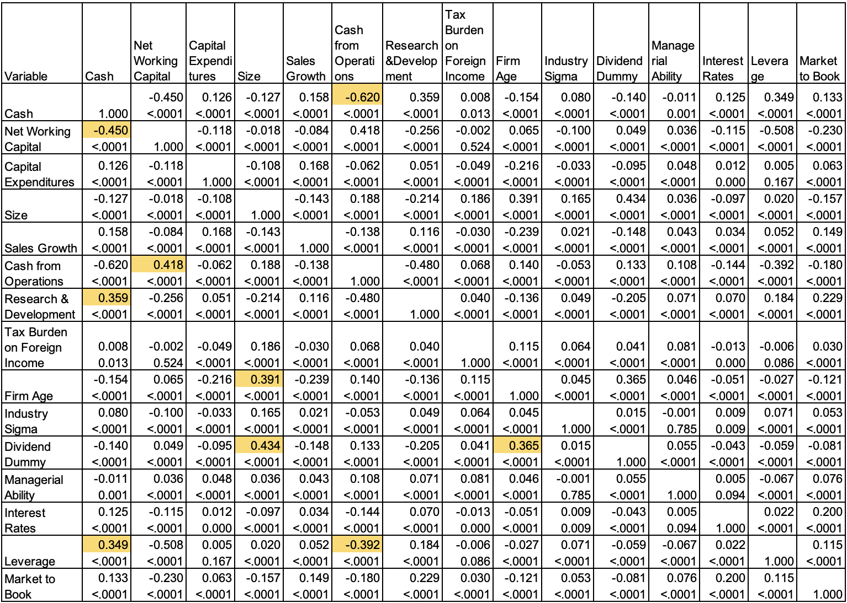
Correlation Matrix
Notes:
Correlation specifically measures the strength and direction of a linear relationship between two variables.
In the context of descriptive statistics, correlation provides information about the degree to which two variables vary together. It is often expressed as a correlation coefficient, such as the Pearson correlation coefficient, which quantifies the strength and direction of a linear relationship between two continuous variables.
From the above table results, we know the strength and magnitude of the relation between Cash and other variables. Key relationships are as below:
Cash from Operations: A strong negative correlation (-0.62) suggests a robust negative linear relationship, indicating that as cash from operations increases, cash estimates tend to decrease.
Research & Development: A moderate positive correlation (0.359) implies that there is a moderate positive linear relationship between research and development and cash estimates.
Leverage: A moderate positive correlation (0.349) suggests a moderate positive linear relationship between leverage and cash estimates.
Net Working Capital: A negative correlation (-0.45) indicates a moderate negative linear relationship, suggesting that as net working capital increases, cash estimates tend to decrease.

Slide 7
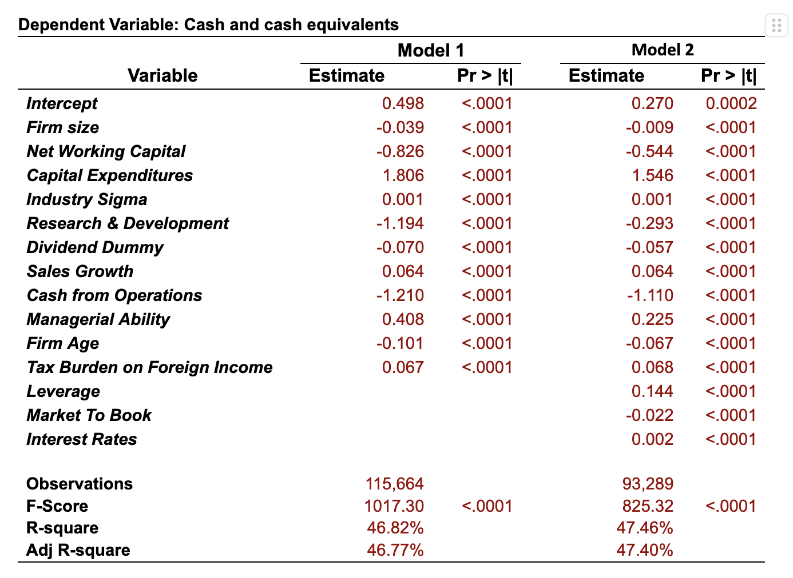
Regression Results
Notes:
Model 1:
Significant Model:
R-squared (46.82%): Indicates a substantial portion (46.82%) of cash flow variability is explained by the included variables.
F-statistic (1017.30): A highly significant p-value (< .0001) confirms the overall model's statistical significance.
Predictor Insights:
Positive Predictors: Capital Expenditures, Industry Sigma, Sales Growth, Managerial Ability, and Tax Burden on Foreign Income positively impact cash flow.
Negative Predictors: Firm Size, Net Working Capital, Research & Development, Dividend Dummy, Firm Age, and Cash from Operations have adverse effects on cash flow.
Model 2:
Enhanced Model:
R-squared (47.82%): Shows an improved explanatory power (47.82%) with the addition of Leverage, Market to Book, and Interest Rates.
F-statistic (825.32): The highly significant p-value (< .0001) reinforces the overall model's statistical significance.
Additional Predictors:
Positive Influencers: Capital Expenditures, Industry Sigma, Sales Growth, Managerial Ability, Tax Burden on Foreign Income, and Interest Rates contribute positively to cash flow.
New Negative Predictors: Firm Size, Net Working Capital, Research & Development, Dividend Dummy, Firm Age, Market To Book - these exhibit adverse effects on cash flow, offering a nuanced understanding.
We also see consistent results in terms of signs for all the variables in both models.

Slide 8
Key Recommendations
Working Capital Management:
Streamline inventory and improve accounts receivable collection.
Strategically manage accounts payable by negotiating favorable terms.
Sales Growth Strategies:
Implement strategies for sustainable revenue growth.
Expand market share, introduce new products, and enhance sales efforts.
Capital Expenditures and Strategic Investments:
Firms must prioritize projects aligned with their long-term goals, optimize financing, and carefully monitor returns which closely ensures effective capital management,
Strategic investment helps to acquire, upgrade, and maintain physical assets such as property, plants, buildings, technology, or equipment.
Cash from Operations Optimization:
Enhancing operational processes for increased cash generation.
Helps to provide liquidity for day-to-day activities in business.
Interest Rates and Leverage:
Stay vigilant to changes in interest rates for strategic financial planning.
Manage debt levels carefully helping in balancing growth and financial stability.
Notes:
Based on the modeling results, as explained earlier, we see there are few important predictors which has major influence on the cash estimated. As our estimation is based on all the firms, so we suggest few generic key recommendations that would help all the firms to maintain sufficient cash.

Slide 9
Limitations
Data Limitations:
Unavailability of 'Cash from operations' data before 1987 restricts historical analysis.
Numerous missing values replaced with zeros, potentially introducing bias.
Need for broader data coverage in future analyses.
Industry and Environment Variability:
Different sectors or unique company characteristics may exhibit distinct cash management patterns.
Exclusion of the utility and financial firms due to their unique additional regulatory constraints on the cash and investments bring restrictions to analysis.
External Factors and Unforeseen Events:
Model may not fully capture the influence of external macroeconomic factors or unforeseen events on cash reserves.
Economic fluctuations, regulatory changes, or crises could impact cash in ways beyond our modeled variables.
Caution in Generalizing Findings:
Findings and recommendations do not universally apply to all companies.
Each organization is unique and and adjustments should be made accordingly.
Along with our findings, it's crucial to acknowledge the limitations we encountered.
Notes:
Through our cash estimation models, we discussed multiple outcomes of the predictors for keeping sufficient cash.
Along with our findings, it's crucial to acknowledge the limitations we encountered.
By addressing these limitations transparently, we ensure a nuanced and informed interpretation of our findings, fostering more robust decision-making.

Slide 10
Thank You
Q&A

